Slide 1
Track 1.5C industry dialogue
Thinking Ahead For Europe
Wed 19 Oct
Milan Elkerbout
Head of Climate Policy

Slide 2
The challenge of net-zero / 1.5C pathways
Net zero requires action in all sectors, including transport, agriculture, industry (“hard-to-abate”) => 25% GHG emissions, full value chain = 50% “transform our economies”
“hard-to-abate” = going beyond marginal (energy/carbon) reduction -> new production processes
Development and deployment of low-carbon breakthrough technologies to transform production and products (green steel, green cement etc.)
Reduce resources and material demand: circular economy
Technologies exist or will exist by 2030: currently in demonstration phase, e.g. CCS - 1st full value chain CCS projects, hydrogen, chemical recycling, green steel, etc.
Industrial roadmaps exist, for many sectors and countries
Money for innovation is made available (but mostly early-stage innovation)
Missing: a policy framework to make it happen -> to deploy low-carbon technology at scale

Slide 3
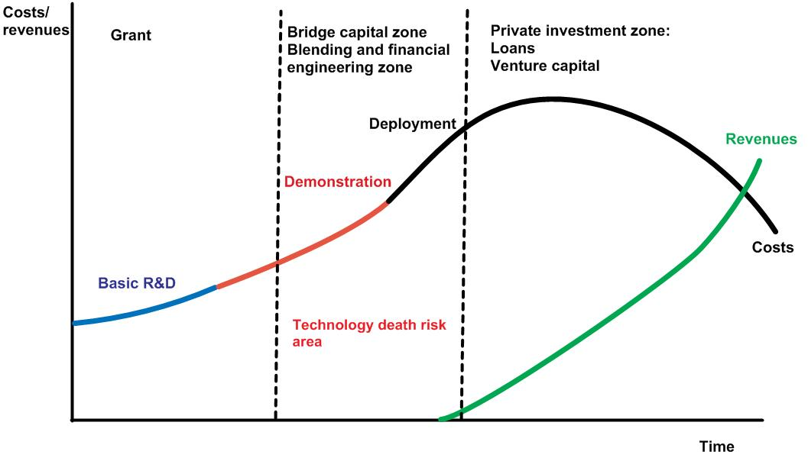
Innovation: the valley of death
Pre-competitive
Almost competitive

Slide 4
Future low-carbon value chains

Slide 5
Key technology clusters
Renewable energy
Batteries
Hydrogen
Carbon capture and storage
Negative emissions

Slide 6
Technology: building blocks for the low-carbon transition
Low carbon electricity
Renewable energy: wind, solar, biomass/biofuel
Nuclear energy
CCS (as transition?)
Electricity and hydrogen as energy carriers: electricity and hydrogen storage – batteries, electrolyzers
Energy efficiency
Electrification
Combined heat & power
Insulation technologies → materials
Infrastructure
Interconnected electricty grids, charging stations, digital infrastructure, CO₂ pipes, hydrogen pipelines – low-carbon materials

Slide 7
Technology: building blocks for the low-carbon transition
Industrial decarbonisation
Low-carbon energy and material feed-stocks, e.g. low-carbon hydrogen, low-carbon electricity, biomass, re-used or recycled or circular materials
New processes, e.g. H-DRI/EAF steel; new cement types with low-clinker contents; CCS (process emissions); Biomethanol-to-Olefins (chemicals); zero-carbon aluminium
Tackling residual emissions
Sinks: forests, agriculture land, soil, etc.
CCS, CCU (permanence), BECCS
Negative emissions technology: Direct air capture, biochar, enhanced weathering, ocean alkalisation, ocean fertilisation
Bioeconomy
Biofuels
Material substitution
Sinks

Slide 8
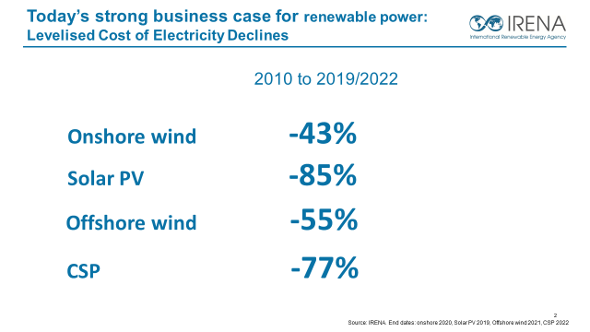
Technology costs: can they continue to fall across the board?
Technology learning curve = with each doubling of capacity of immature technologies technology costs fall by around 20%
Tailor-made support policy
Feed-in tariffs:
Long-term contracts (up to 20y)
Fixed payment for each kWh produced (⬄ no price risk)
Net support costs passed on to consumers
Effective policy
Installed capacity in 2015:
Wind: 42 GW (+150% since ’04)
Solar: 40 GW (+3580% since ‘04)
Feed-in tariffs for Solar:
≤ 57 ct/kWh (2004)
≤ 13 ct/kWh (2014)
-80%
Will this happen for batteries; electrolysers; carbon capture; industrial heat pumps etc?
Depends on homogeneity; economies of scale; sensitivity to local conditions

Slide 9
What policy initiatives?
Domestic policy mix: comprehensive set of tools, not single fixes
Carbon pricing: disincentivize most-carbon-intensive; support investment case
Industrial and innovation policies: bring down green premium over time
Demand-side measures & circularity: create markets, reduce resource demand
Global/cooperative approaches:
Clubs and alliances? Focus more on carrots than sticks
Initiatives such as LeadIT – public-private collaboration and (cross)-sectoral learning
UNFCCC Technology Mechanism: Climate Technology Centre & Network

Slide 10
Beyond technology and costs
Technologies may not be adopted even once cheap (permits, planning, infrastructure)
Distributional and social implications: who pays? - domestically/globally
Geography of industrial production will change considerably
Social acceptance of some technologies. Impacts on lifestyles

Slide 11
www.ceps.eu
info@ceps.eu
Thank you!
@CEPS_thinktank
CEPS (Centre for European Policy Studies)

